Slide 1

Struktur Data
Queues
Prepared by
Frans Panduwinata, S.Kom, M.T

Slide 2
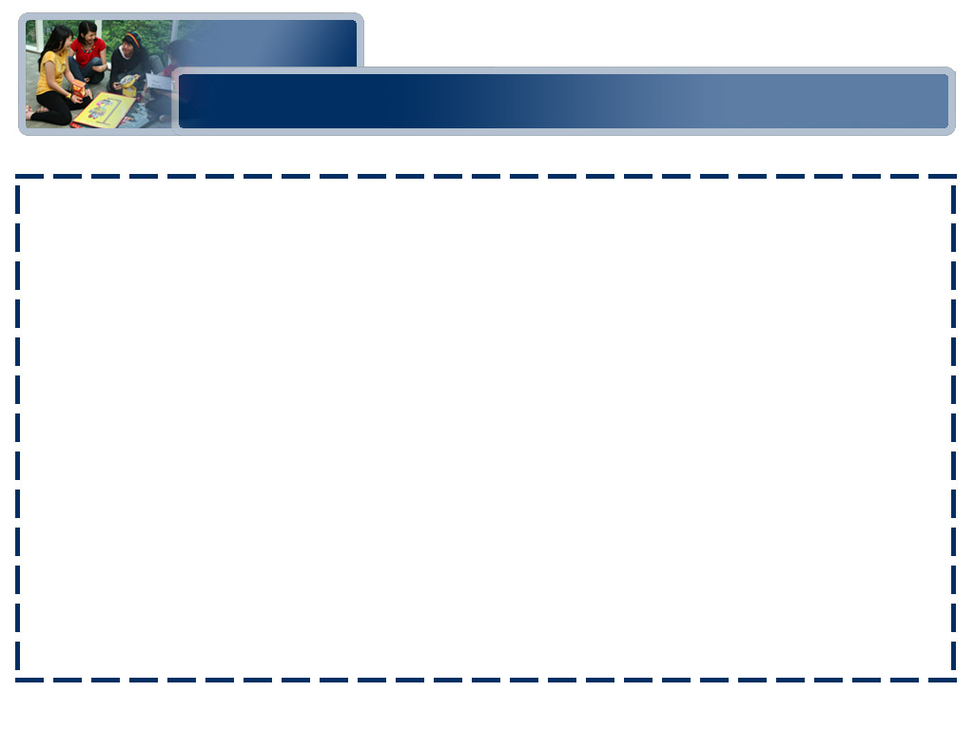
Introduction
A queue is also a list of elements with insertions permitted at one end—called the rear, and deletions permitted from the other end—called the front.
This means that the removal of elements from a queue is possible in the same order in which the insertion of elements is made into the queue.

Slide 3
Introduction (cont)
Thus, a queue data structure exhibits the FIFO (first in first out) property.
Insert and delete are the operations that are provided for insertion of elements into the queue and the removal of elements from the queue, respectively.

Slide 4
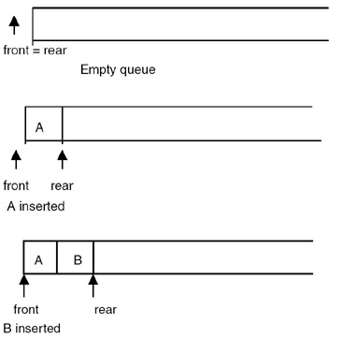
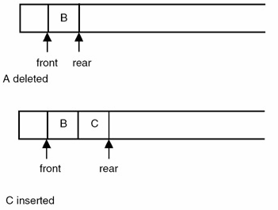
Introduction (cont)
Shown in figures below are the effects of insert and delete operations on the queue.

Slide 5
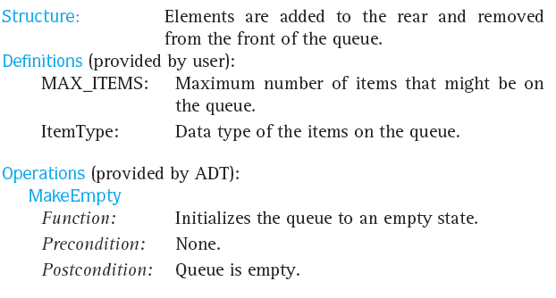
Queue ADT Specification

Slide 6
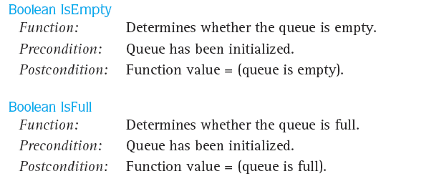
Queue ADT Specification (cont)

Slide 7
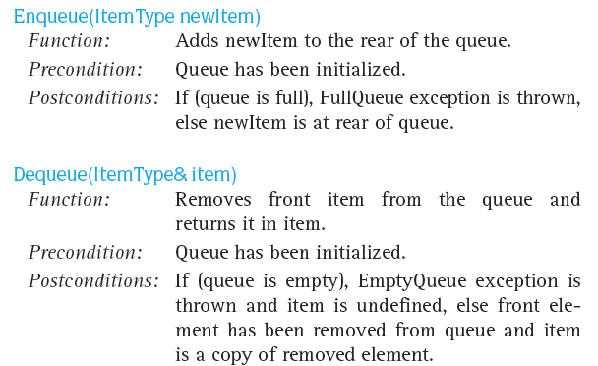
Queue ADT Specification (cont)

Slide 8
Array Implementation
An array implementation of a queue is a bit trickier than that of a stack.
Insertions can be made in a left-to-right fashion as with a stack.
However, deletions must now be made from the left.
The addition of an element to a queue is known as an enqueue, and removing an element from the queue is known as a dequeue.

Slide 9
Array Implementation (cont)
EXAMPLE: (Insert Function)
void insert(int queue[], int *rear, int value)
{
if(*rear < MAX-1) //MAX = 10
{
*rear= *rear +1; //initial rear = -1
queue[*rear] = value; //value is the value that //inserted by user
}
else
{
printf("The queue is full can’t insert a value\n");
exit(0);
}
}

Slide 10
Array Implementation (cont)
EXAMPLE: (Delete Function)
void delete(int queue[],int *front, int rear, int *value)
{
if(*front == rear) //initial front = -1
{
printf("The queue is empty can’t delete a value\n");
exit(0);
}
*front = *front + 1;
*value = queue[*front]; //value is the deleted value
}

Slide 11
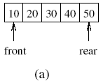
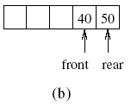
Array Implementation (cont)
EXAMPLE:
Consider a simple example of an array of size 5 into which the integers 10, 20, 30, 40, and 50 are inserted as shown in figure (a). Suppose three elements are subsequently deleted (figure (b)).
What if we are now required to insert the integer 60?

Slide 12
Array Implementation (cont)
EXAMPLE: (cont)
  It appears that we are out of room as there is no more place to the right of 50.
  On the other hand, there are three locations available to the left of 40.
  This suggests that we use a Circular Array implementation of a queue.

Slide 13
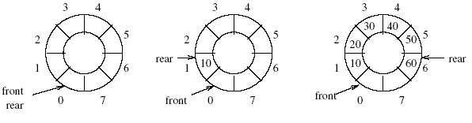
Circular Array
Implementation of a queue in a Circular Array:
  The first figure shows an empty queue with first = rear = 0.
  The second figure shows the queue after the integer 10 is inserted.
  The third figure shows the queue when 20, 30, 40, 50, and 60 have been inserted.

Slide 14
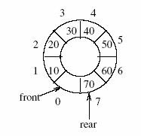
Circular Array (cont)
Implementation of a queue in a Circular Array: (cont)
  The fourth figure shows the queue after 70 is inserted.

Slide 15
Circular Array (cont)
Code sample for insert and delete in queue:
void Queue::Insert(int x)
{
int k = (rear + 1) % size;
if (front == k) cerr << "Queue Full!" <, endl;
else queue[rear = k] = x;
}
Int *Queue::Delete(int &x)
{
if (front == rear) return 0; // queue is empty
x = queue[++front %= size];
return &x;
}

Slide 16
Circular Array (cont)
Note for fourth figure:
  Although one slot remains empty, the queue is now full because Queue::Insert will not permit another element to be inserted.
  If it did permit an insertion at this stage, rear and front would be the same.
  This is the condition that Queue:Delete checks to determine whether the queue is empty!
  This would make it impossible to distinguish between the queue being full and being empty.
  So, a circular queue is a queue in which the element next to the last element is the first element.

Slide 17
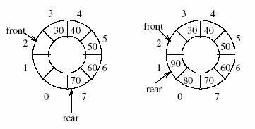
Circular Array (cont)
Implementation of a queue in a Circular Array: (cont)
  The fifth figure shows the queue after two integers (10 and 20) are deleted.
  The last figure shows a full queue after the insertion of integers 80 and 90.

Slide 18
Applications
One application of the queue data structure is in the implementation of priority queues required to be maintained by the scheduler of an operating system.
It is a queue in which each element has a priority value and the elements are required to be inserted in the queue in decreasing order of priority.
This requires a change in the function that is used for insertion of an element into the queue. No change is required in the delete function.

Slide 19
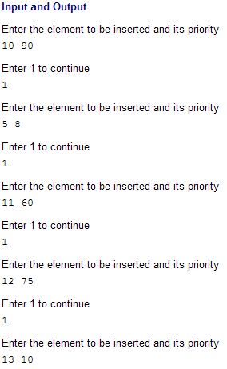
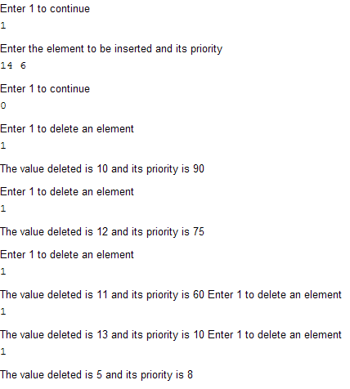
Applications (cont)

Slide 20
Applications (cont)
Another EXAMPLE:
  In a multitasking operating system, the CPU time is shared between multiple processes.
  At a given time, only one process is running, all the others are ‘sleeping’. The CPU time is administered by the scheduler.

Slide 21
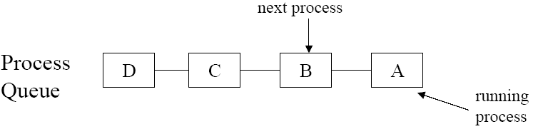
Applications (cont)
Another EXAMPLE: (cont)
  The scheduler keeps all current processes in a queue with the active process at the front of the queue.

Slide 22
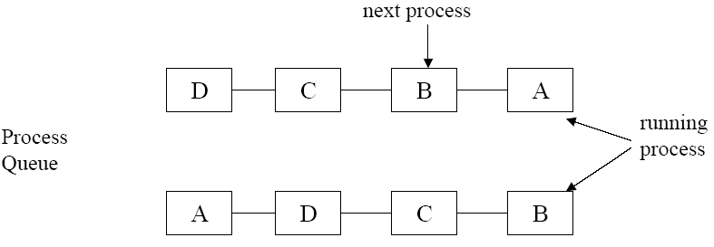
Applications (cont)
Round-Robin Scheduling:
Every process is granted a specific amount of CPU time, its ‘quantum’. If the process is still running after its quantum run out, it is suspended and put towards the end of the queue.

Slide 23
Exercises
Write a program using queue, pointers and functions.
Input 5 data
Data 1: 7
Data 2: 10
Data 3: 51
Data 4: 19
Data 5: 1
Press 1 to insert
Press 2 to delete
Press 3 to reset
Your input: 2
7 10 51 19 1
Which data do you want to delete?
10
51 19 1 7
Your input: 1
Insert number: 11
51 19 1 7 11

